Slide 1
Mobile Cloud
Zonghua Gu

Slide 2
Topics
Performance Evaluation of Android or Linux (Easy)
Integrating Android with Xenomai or RTAI (Hard)
Enhancing OSGi with real-time Java support (Medium)
Mobile cloud: offloading computation from mobile device to server (Hard)

Slide 3
Performance Evaluation of Android or Linux

Slide 4
Performance Evaluation of Android or Linux
Run some real-time performance benchmarks on Android running on an embedded HW platform,
Can use a laptop computer, or a mobile phone, or an embedded development board.
Can run Java applications on Dalvik VM, or native C applications (e.g., rt-tests, Lachesis…) through JNI (Java-Native Interface)
Can run performance comparisons between Davik applications and Native C applications

Slide 5
References
Andrea Claudi and Aldo Franco Dragoni, Lachesis: a testsuite for Linux based real-time systems, Real-Time Linux Workshop 2011
https://lwn.net/images/conf/rtlws-2011/proc/Claudi.pdf
RT-Tests
https://rt.wiki.kernel.org/
Bhupinder S. Mongia et al, Reliable Real-Time Applications on Android OS
www.ece.gatech.edu/~vkm/Android_Real_Time.pdf
Sangchul Lee and Jae Wook Jeon, Evaluating Performance of Android Platform Using Native C for Embedded Systems, International Conference on Control, Automation and Systems 2010
Cheng-Min Lin et al, Benchmark Dalvik and Native Code for Android System, Second International Conference on Innovations in Bio-inspired Computing and Applications 2011
Adam Lackorzynski, Real-Time Performance of L4Linux, Real-Time Linux Workshop 2011
https://lwn.net/images/conf/rtlws-2011/proc/Peter.pdf

Slide 6
Integrating Android with Xenomai or RTAI

Slide 7
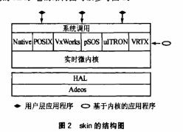
Integrating Android with Xenomai or RTAI
RTAI or Xenomai: A patch to the Linux kernel which introduces a hardware abstraction layer
Linux kernel is run as a background task that runs when no real time task is running.
Linux application is able to execute without any modification
Idea: port Android to run on top of RTAI or Xenomai
Android
Notes:
A broad variety of services which make realtime programmers' lifes easier
RTAI provides deterministic response to interrupts, POSIX compliant and native RTAI realtime tasks.
Hard real-time extension to the Linux kernel
Consists of:
1 I/F to Linux HW Management (HAL): basically a data structure.
3 basic components (dispatcher, scheduler, fifo's).
1 I/F (set of functions) used in user tasks to initialize and start the components.
From a Linux point of view these entities populate modules.

Slide 8
References
Xenomai Website
http://www.xenomai.org
实时化解决方案Xenomai的原理及应用
http://embed.chinaitlab.com/linux/874901.html
韩守谦，裴海龙，王清阳, 基于Xenomai的实时嵌入式Linux操作系统的构建,计算机工程与设计, 2011, 32(1)
RTAI Website
https://www.rtai.org/
RTAI分析
http://hi.baidu.com/ilbx/blog/item/717feed17870d5da562c845a.html

Slide 9
Enhancing OSGi with real-time Java support

Slide 10
Enhancing OSGi with real-time Java support
P. Basanta-Val*,†, M. García-Valls and I. Estévez-Ayres， SPE 2012
OSGi was designed with embedded systems in mind, its current support is insufficient for coping with one main characteristic of many embedded systems: real-time performance. This article analyzes different key issues in providing OSGi with real-time Java performance covering motivational issues, and different integration ways and challenges stemming from the integration. It also contributes a general framework for introducing real-time performance in OSGi, which is called the real-time for OSGi framework. The framework uses real-time Java virtual machines and the real-time specification for Java. The adoption of this framework allows cyber-physical systems to experience real-time Java performance in their applications. The framework introduces several integration levels for OSGi and real-time specification for Java, and specific real-time OSGi services. An empirical implementation was carried out using standard software, which was extended with the new defined services.

Slide 11
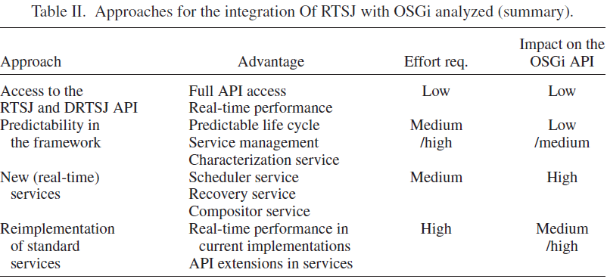
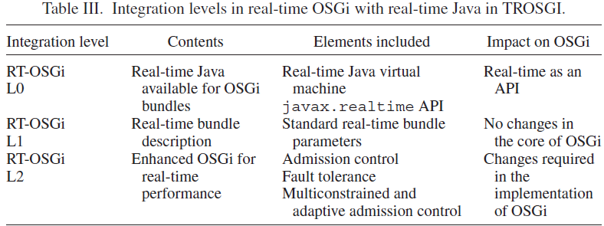

Slide 12
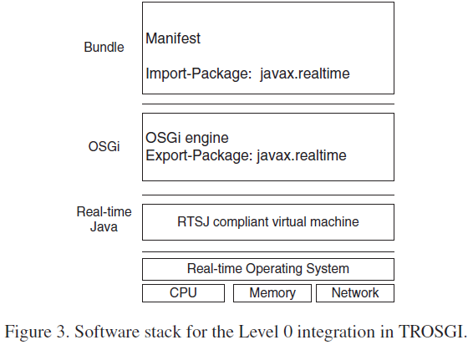
Level-0 Integration
Application sees real-time Java as another API available for applications. There are no changes in OSGi
VM should support javax.realtime API.
OS should offer real-time performance to the real-time Java virtual machine.
The OSGi engine should export javax.realtime to the bundles. By default, the OSGi
environment hides all javax.* classes to the upper layers. To access to the API, it requires
that the API is exported in the framework.

Slide 13
Mobile cloud: offloading computation from mobile device to server

Slide 14
Remote Execution Approaches
Two approaches:
MAUI (Microsoft) and Chroma: conduct remote execution in the granularity of RPCs and their inputs and outputs.
CloneCloud and Cloudlets: conduct remote execution by migrating a VM from the mobile device to a remote server by emulating the entire mobile OS on the server, in order to preserve the software environment of executed functions.
RPC migration is more lightweight, and adapts well to unstable wireless network conditions.

Slide 15
MARS: adaptive remote execution for multi-threaded mobile devices
MARS, the first adaptive, online and lightweight RPC-based remote execution scheduler supporting multi-threaded and multi-core systems.
MARS uses an efficient offloading decision algorithm that takes into account the inherent trade-offs between communication and computation delays and power consumption. Due to its lightweight design, MARS runs on the device itself, instantly adapts its decisions to changing wireless resources, and supports any number of threads and cores.

Slide 16
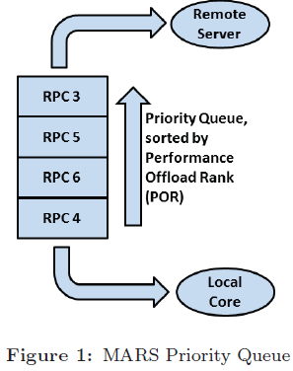

A priority queue of all candidate RPCs, sorted by POR
Highest POR RPC is sent to remote server
Lowest POR RPC is executed locally
Similarly: EOR (Enery Offload Rank)
Notes:
estimates the energy that would be saved on the device by offloading the RPC over executing it locally

Slide 17
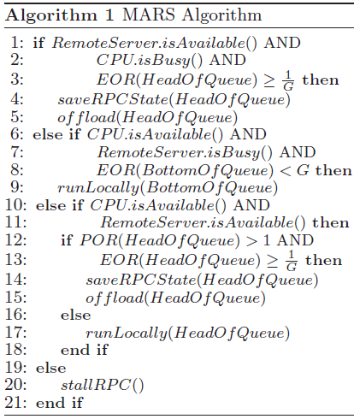
MARS Algorithm
First, given a set of remote execution RPCs, it attempts to keep both the network and the CPU fully utilized at all times, as long as using a resource will significantly improve the energy efficiency of the mobile device.
Second, remote execution RPCs with high POR are executed remotely, and RPCs with low POR are executed locally.

Slide 18
MAUI vs. MARS
MAUI uses ILP to find optimal partitioning of the application task graph
Computationally intensive, runs on the server
MARS uses lightweight heuristics
Very efficient, runs on the device

Slide 19
CloneCloud
Developed by Intel Research Lab Berkeley: move the smart phones to the cloud computing environment.
CloneCloud uses a smart phone’s high-speed network connection to communicate with a copy of itself that lives in a cloud-computing environment on remote servers.
The clone on the Cloud is much more powerful than the actual smart phone and when the user executes a particular task, it is done either on the phone or on the cloud depending on the resources needed for the task. In the later case the results are reintegrated back on the smart phone.

Slide 20
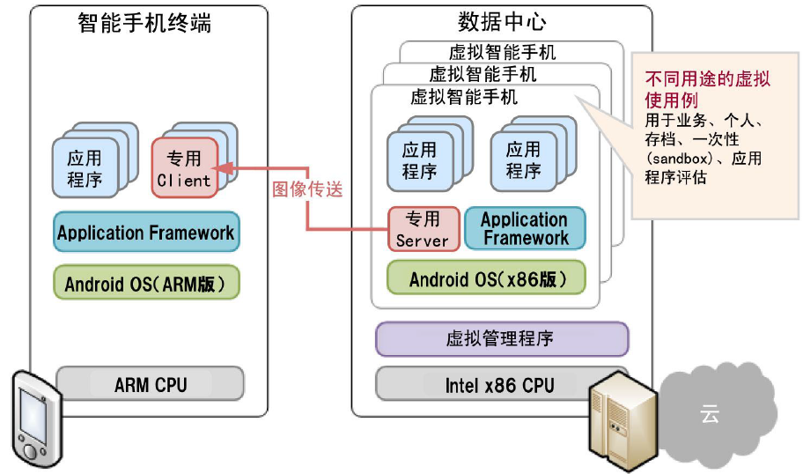
CloneCloud Architecture

Slide 21
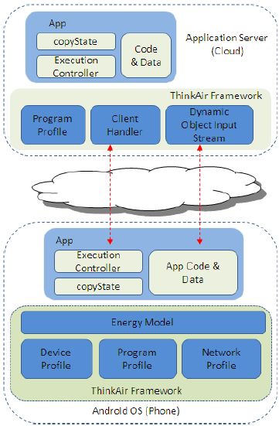
ThinkAir
ThinkAir exploits the concept of smartphone virtualization in the cloud and provides method-level computation offloading, parallelizing method execution using multiple VM images.
(1) provides an efficient way to perform on-demand resource allocation,
(2) exploits parallelism by dynamically creating, resuming, and destroying VMs in the cloud when needed.
Any method to be considered for offloading is annotated with @Remote.

Slide 22
Profiler
Three profilers (hardware, software, and network)
Use Android intents to register listeners with the system to track battery levels, data connectivity presence, and connection types (WiFi, cellular, etc.) and subtypes (GPRS, UMTS, etc.).

Slide 23
HW Profiler
CPU. The CPU can be idle or have a utilization from 1–100% as well as different frequencies;
Screen. The LCD screen has a brightness level between 0–255;
WiFi. The power state of WiFi interface is either low or high;
3G. The 3G radio can be either idle, or in use with a shared or dedicated channel.

Slide 24
SW Profiler
Uses the standard Android Debug API to record the following information.
Overall execution time of the method;
Thread CPU time of the method, to discount the affect of pre-emption by another process;
Number of instructions executed;
Number of method calls;
Thread memory allocation size;
Garbage Collector invocation count, both for the current thread and globally.

Slide 25
Network Profiler
Combines both intent and instrumentation-based profiling.
In addition, the Network Profiler tracks several other parameters for the WiFi and 3G interfaces, including
the number of packets transmitted and received per second
uplink channel rate and uplink data rate for the WiFi interface,
receiving and transmitting data rate for the 3G interface.

Slide 26
Energy Estimation Model
Uses PowerTutor model which accounts for power consumption of CPU, LCD screen, GPS, WiFi, 3G, and audio interfaces on HTC Dream and HTC Magic phones.
We modify the original PowerTutor model to accommodate the fact that certain components such as GPS and audio have to operate locally and cannot be migrated to the cloud.

Slide 27
Experiment Setup
Four different connectivity scenarios
Phone. Everything is executed on the phone;
WiFi-Local. The phone directly connects to a WiFi router attached to the cloud server via WiFi link;
WiFi-Internet. The phone connects to the cloud server using a normal WiFi access point via the Internet;
3G. The phone is connected to the cloud using 3G data network.
Application examples
N-Queens puzzle
Face detection
Virus scanning
Images combiner

Slide 28
References
Asaf Cidon, Tomer M. London, Sachin Katti, Christos Kozyrakis, Mendel Rosenblum (Stanford), MARS: adaptive remote execution for multi-threaded mobile devices, MobiHeld 2011
Sokol Kosta, Andrius Aucinas, Pan Hui, Richard Mortier, Xinwen Zhang: Unleashing the Power of Mobile Cloud Computing using ThinkAir INFOCOM: 2012
http://www.thinkair.net/
Intel CloneCloud
http://berkeley.intel-research.net/bgchun/clonecloud/

